Slide 1
Service Software Product Ordering System (SSPOS)

Slide 2
Topics Covered
What the System is
How to Access the System
How to create an order (the order process)
How to search for an order
How to manage your subscription list
Review subscription history
Review Dealer Position
Review and/or change the quantity in an order
Delete subscriptions

Slide 3
The management of
SIS DVD, Cat ET disks, and Second-Level Dealer Packages is completed through the
Service Software Product Ordering System
SSPOS

Slide 4
Accountability
SSPOS enables the Dealer Admin the opportunity to:
Simplify subscription management
Assume ordering capability
Perform maintenance of dealer position codes
Enable dealers to manage SIS DVD & Cat ET media from one centralized website

Slide 5
Accessing the SSPOS
2 Ways to Access:
*Use the same log on credentials on both websites
1) Direct → Go through the SSPOS URL:
https://oos.midlandcorp.com/sis
2) Indirect → go through a link in the MOOS website:
https://oos.midlandcorp.com/cat

Slide 6
Logging Into the System
Username & Password Required
Users must be registered in the Media Online Ordering System (MOOS) before access to the SSPOS system can be granted
If NOT already registered, please submit a registration form through the MOOS website using the Registration link

Slide 7
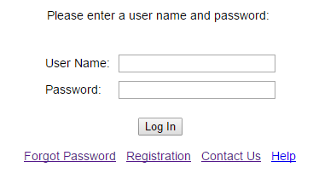
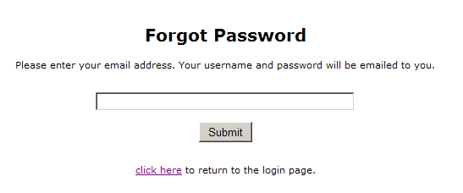
Forgot Password?
An auto-generated email with your username and password will be sent

Slide 8
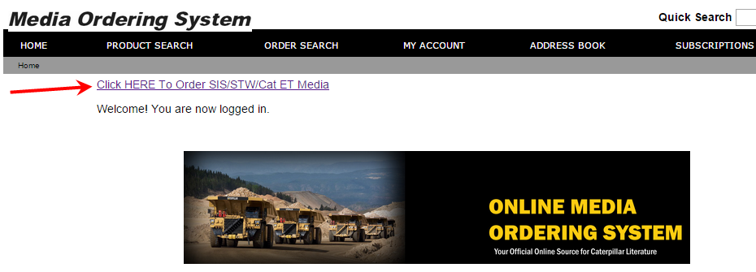
Indirect → Going through MOOS
1) Log into https://oos.midlandcorp.com/cat
2) Use the link on the homepage titled “Click HERE to Order”

Slide 9
Direct → Logging into SSPOS
1) Log into https://oos.midlandcorp.com/sis

Slide 10
Order Process

Slide 11
Order Process
Select Disc Type and Media
Add to Shopping Cart
Verify Shipping Info / Cart Contents
Submit Order (Check Out)
Receive Confirmation (# and email)
Check Order Status
Select Disc Type
Add to Shopping Cart
Verify Shipping Info & Contents
Submit Order (Check Out)
Receive Confirmation #
Check Order Status

Slide 12
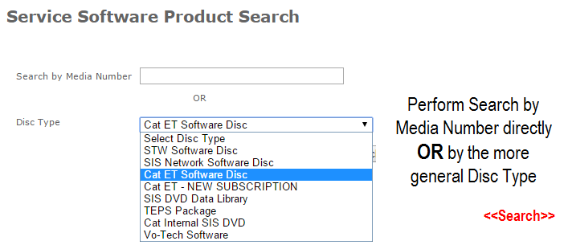
Select Disc Type
Select Disc Type
Add to Shopping Cart
Verify Shipping Info & Contents
Submit Order
Receive Confirmation #
Check Order Status

Slide 13
Select Media
Add to cart – one line at a time
Select Disc Type
Add to Shopping Cart
Verify Shipping Info & Contents
Submit Order
Receive Confirmation #
Check Order Status

Slide 14
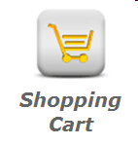
Shopping Cart
Available edits: Quantity (more or less), Remove, Check Out
Select Disc Type
Add to Shopping Cart
Verify Shipping Info & Contents
Submit Order
Receive Confirmation #
Check Order Status

Slide 15
Submit Order (Check Out) Verify Shipping Information
Dealer Position (deliver to) must be created or selected to continue
Select Disc Type
Add to Shopping Cart
Verify Shipping Info & Contents
Submit Order
Receive Confirmation #
Check Order Status

Slide 16
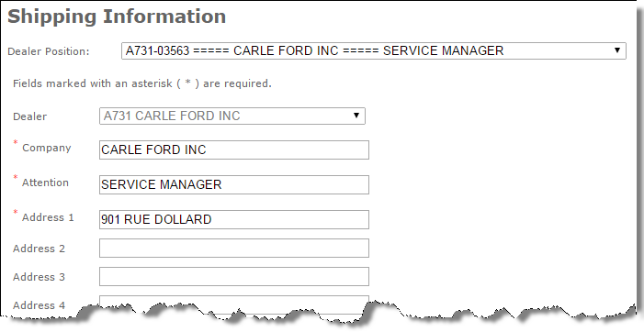
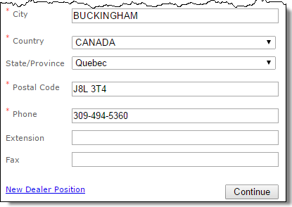
Shipping Information Complete – Edit – Continue
Select Subscriptions
Add to Shopping Cart
Verify Shipping Info & Contents
Submit Order
Receive Confirmation #
Check Order Status

Slide 17
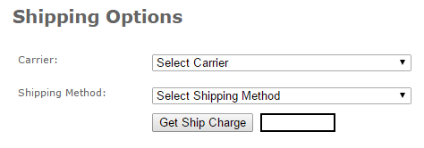
Shipping Options
United States
UPS: Ground, Next Day Air, 2nd Day Air, 3 Day Select
Get Ship Charge after making carrier and shipping method choices
International
UPS: Worldwide Express, Worldwide Expedited, Worldwide Saver
DHL: Worldwide Express, Worldwide Expedited, Worldwide Saver
Select Subscriptions
Add to Shopping Cart
Verify Shipping Info & Contents
Submit Order
Receive Confirmation #
Check Order Status

Slide 18
Tax Terms & Conditions
Please review the tax terms and conditions below and select the 'I accept' button. You must accept these terms and conditions before continuing with your order.

Slide 19
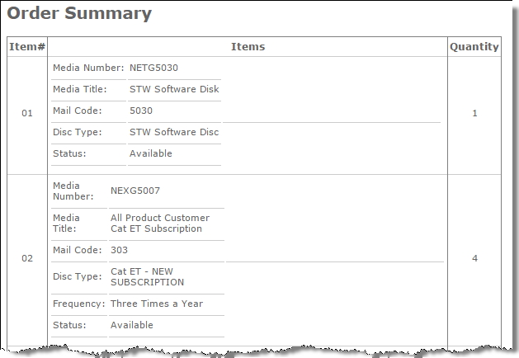
Order Summary Verify – Modify – Submit
Please note:
Be sure to make any changes at this point. Once an order is submitted, the order cannot be changed or cancelled.
Select Disc Type
Add to Shopping Cart
Verify Shipping Info & Contents
Submit Order
Receive Confirmation #
Check Order Status

Slide 20
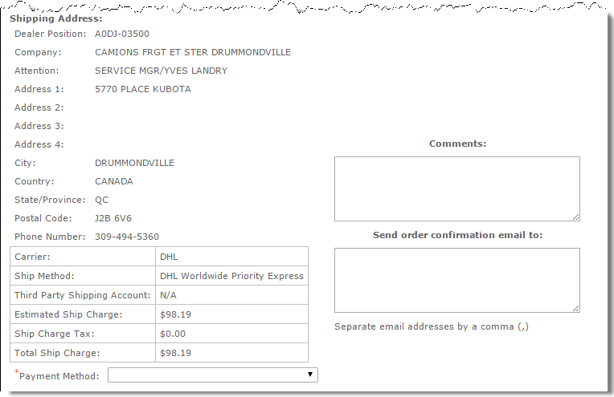
Order Summary - continued Verify – Modify – Submit
Please note:
Be sure to make any changes at this point. Once an order is submitted, the order cannot be changed or cancelled.
Enter additional email addresses for someone else to receive a confirmation of the order.
Select Disc Type
Add to Shopping Cart
Verify Shipping Info & Contents
Submit Order
Receive Confirmation #
Check Order Status

Slide 21
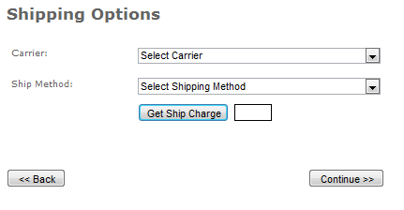
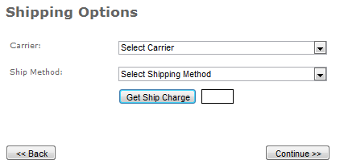
Shipping Selection Examples
International
United States

Slide 22
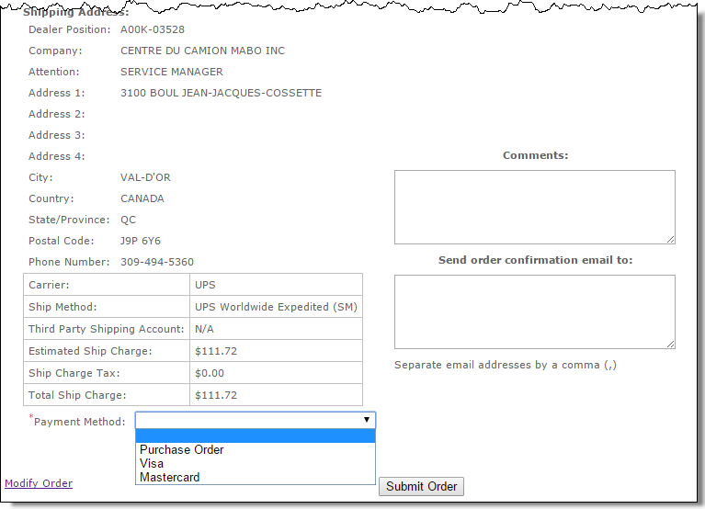
Order Summary
Shipping costs for initial orders are the responsibility of the Dealer.
Payment Method:
Purchase Order, Visa or Mastercard

Slide 23
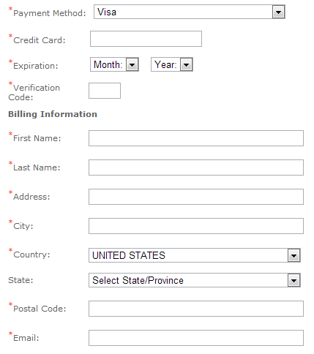
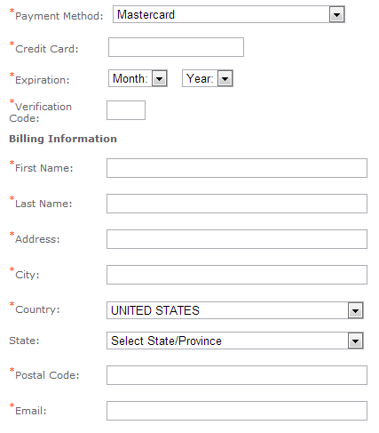
Credit Card Information
The credit card will not be charged until the item actually ships.

Slide 24
PO Number Information
Reference field used to track shipping costs. This number will be listed on your bi-monthly bill from Midland for shipping charges.
The number can be anything, including Dealer internal Purchase Order information.

Slide 25
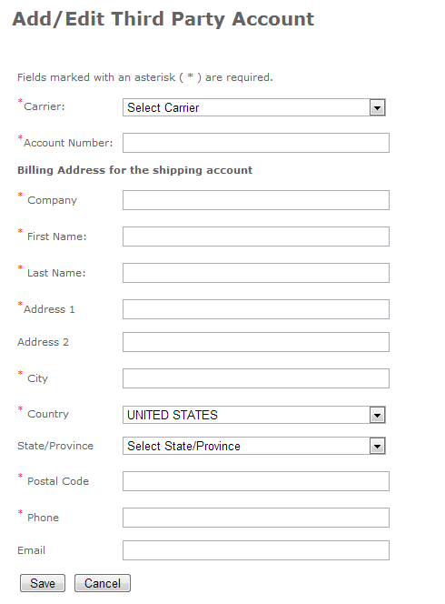
Third Party Account Setup
It is the Dealer’s responsibility to make sure that this information is correct.
If it is incorrect, the system will automatically charge you through Midland.
ALL orders with a United States address must ship using UPS, even if you have an account with a different carrier.

Slide 26
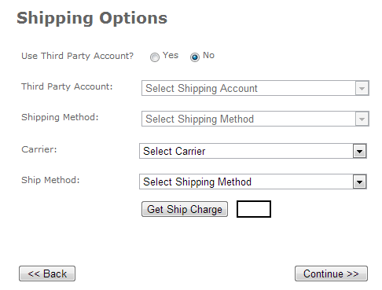
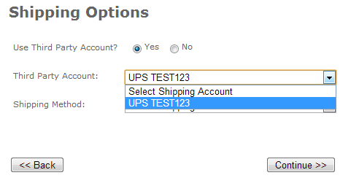
Third Party Account Selection
You must choose the YES button on the Shipping Options page.
Then you may select the Account you have already set up on the site.

Slide 27
Order Confirmation
Confirmation email follows on next page
Select Disc Type
Add to Shopping Cart
Verify Shipping Info & Contents
Submit Order
Receive Confirmation #
Check Order Status

Slide 28
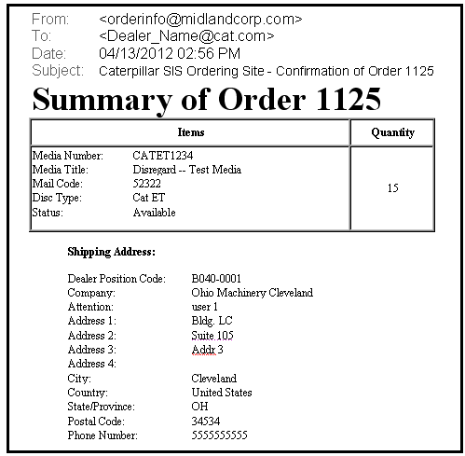
Email Confirmation of Order

Slide 29
Order Search & Details

Slide 30
Order Search
Select Disc Type
Add to Shopping Cart
Verify Shipping Info & Contents
Submit Order
Receive Confirmation #
Check Order Status

Slide 31
Order Search Results
Status Listings:
Pending
In Process
Shipped
Selecting order number provides more detail
Select Disc Type
Add to Shopping Cart
Verify Shipping Info & Contents
Submit Order
Receive Confirmation #
Check Order Status

Slide 32
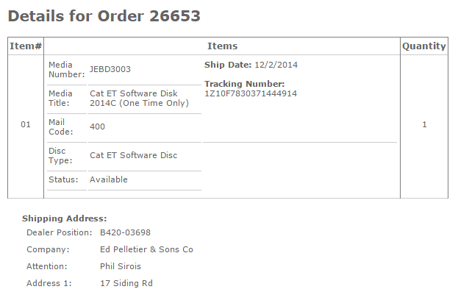
Order Details
Orders are processed at the end of each business day
No Order Changes Allowed

Slide 33
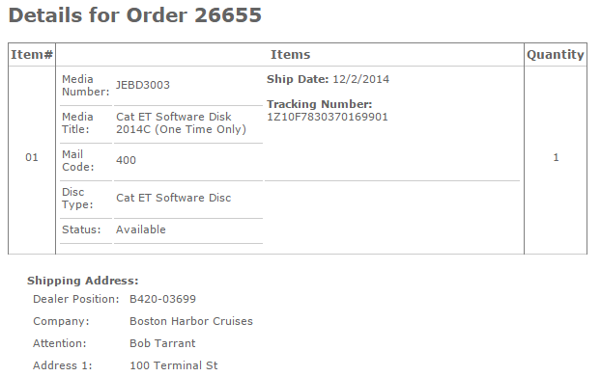
Order Details Updated with Shipping & Tracking Information

Slide 34
Dealer Position

Slide 35
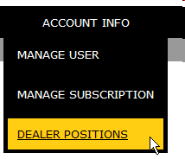
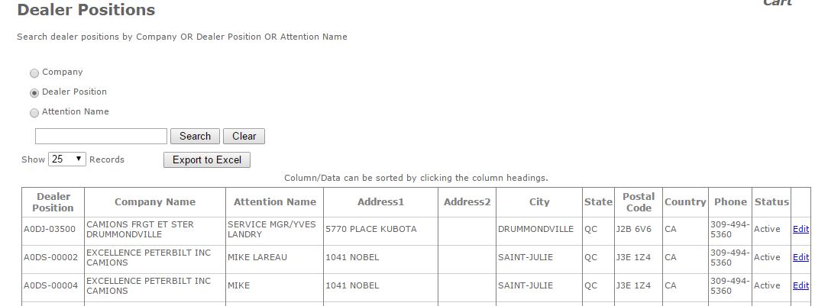
Create or Edit Dealer Position
Dealer position – unique short-hand for a specific address/attention combination

Slide 36
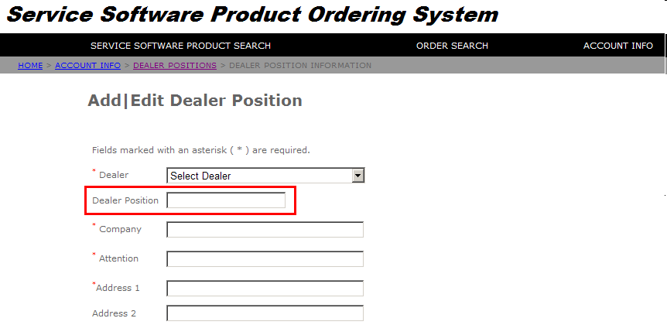
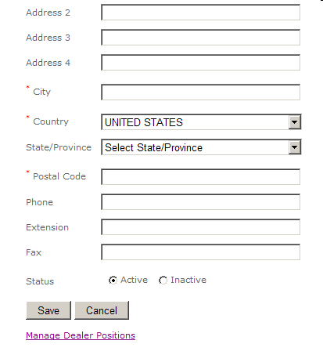
Create Dealer Position – cont.
Upon choosing your Dealer, a unique Dealer Position automatically populates. The Dealer Position cannot be manually changed or entered. This is a protected field – non editable.

Slide 37
Manage Subscription

Slide 38
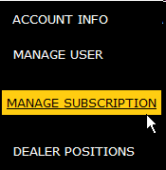
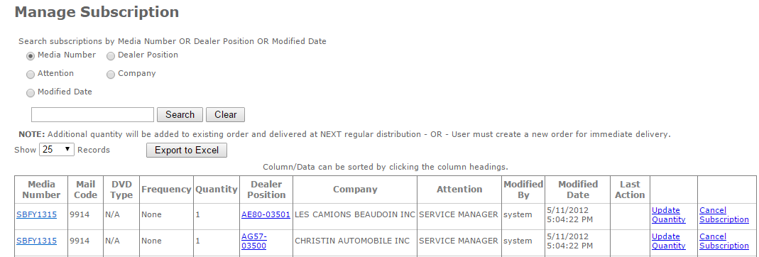
Manage Subscription

Slide 39
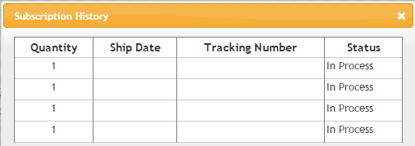
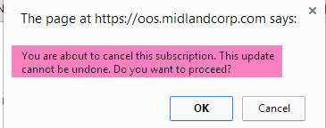
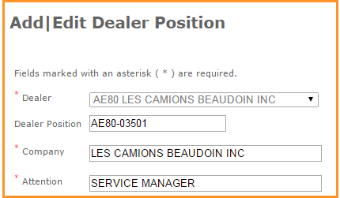
Manage Subscription

Slide 40
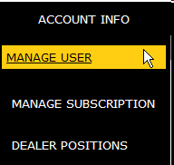
User Management
-SIS Administrators are automatically set up with access.
-Users can add additional users who meet the requirements listed to the left.
Requirements: A CWS ID and prior registration on the MOOS site

Slide 41
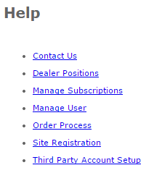
HELP Page
HELP page contains links to PDF documents for step-by-step instructions on the functions available on the site.

Slide 42
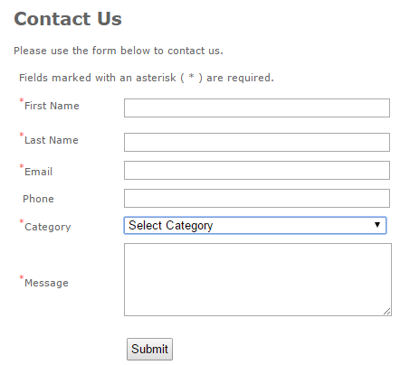
Contact Us
Category selection determines recipient of the “Contact Us” information

Slide 43
Contact Us
For Non-Serivce Software Media Questions,
Research_Media@cat.com
For SIS/Cat ET Product/Subscription Assistance, Technical_Information_Access_Solutions@cat.com
For Technical/Site Issues,
Cat_Support@elandersamericas.com

Slide 44
Action ….. Where to go
Add/allow another person to order discs/subscriptions | My Account –> Manage User
Change quantity on subscription | My Account –> Manage Subscription
Create Unique, Deliver To Mailing Address | My Account -> Dealer Position
Determine which Software to order | Service Software Product Search
Obtain Help, Make Comments | Contact Us
Remove access to the site for a user | My Account –>Manage User
Review and modify order before submission | Shopping Cart
Review status of order | Order Search
Select and Order software / discs | Service Software Product Search
Stop a subscription – don’t renew | My Account –> Manage Subscription
View Current Subscription | My Account -> Manage Subscription

Slide 45
Terminology
Active / Inactive Position Code | Active - on the subscription list, receiving updates Inactive - on the subscription list but not currently receiving updates (on pause)
Dealer Position | Shortened version of the entire ‘deliver to’ address that is tied to both orders & subscriptions
Disc Type | A type (topic) of disc the user is looking for (e.g. a CD or DVD containing different types of service software)
Mail Code | Numeric code for Media Number – unique for distribution supplier used by Caterpillar
Main Dealer | Main Store dealer code assigned by Caterpillar. Acts as a ‘parent’ for dealer branches, TEPS, AMDs, etc.
Media Number | Used by dealers to order media (e.g. JEBD3003)
Order Number | Assigned by the system after order is placed
Pending In Process Shipped | Pending – An order has been placed on the website, but the order has not yet been sent through to the Supplier for fulfillment In process – An order has been sent to the Supplier for fulfillment but has not yet been shipped Shipped – An order has a tracking number and actual shipped date
Subscription | Media item that is periodically updated with new information and sent out at regular intervals throughout the year (similar concept to a magazine subscription).
Subscription list | List of all possible subscription items (media with periodic updates) and their associated Dealer Positions (address information) for a given dealer
Software order | Original request for a media item. Disk is sent on-demand. If the media item is also a Subscription, then it will be placed automatically on the Subscription List. You must “remove” the subscription from the Subscription List if you do NOT wish to receive updates (decline renewal subscription).
User Type | (User) Branch – place order, check on orders, set up dealer position

